Slide 1

Session 3
Pancasila and the World Ideologies

Slide 2

Learning Outcomes:
to describe the differences among Pancasila and other world ideologies

Slide 3

Introduction
Pancasila is one of the ideologies among other ideologies in this world.
Besides Pancasila, we know liberalism and socialism. Liberalism is an ideology adopted by Western nations such as Europe and the United States with all their allies.
Then socialism was embraced by Eastern nations. In the past, the socialism of the Eastern nations was led by the Soviet Union. However, after the Soviet Union broke up into democratic countries as practiced in Western nations, Socialism is now very much influenced by the Chinese state.
Pancasila, as we will discuss below, does not adhere to or support and negate any of these ideologies. Pancasila on the one hand contains the spirit of liberalism, and on the other hand it also contains the spirit of socialism.

Slide 4

(1) Liberalism
Liberalism is a view that places individual freedom as the most important thing in society, both political and economic.
In the political field, liberalism on the one hand supports the minimal possible role of the state, and on the other hand gives maximum freedom to each individual citizen.
Each individual citizen is considered as an autonomous subject who can define himself and his own life goals.
This Photo by Unknown Author is licensed under CC BY-SA-NC

Slide 5
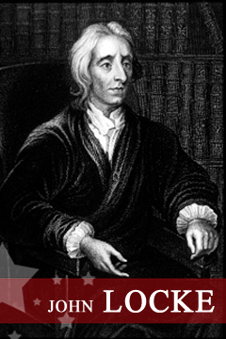
Liberalism (John Locke (29 August 1632 – 28 October 1704)
Political liberalism, philosophically, can be traced to John Locke's view (29 August 1632 – 28 October 1704) on the role of the state over citizens.
John Locke is known as a British political philosopher who influenced the development of political liberalism.
According to Locke, the state was founded primarily to protect private property. The state in this case was not established to create equality of private property rights, but merely limited itself to protecting private property rights. The state does not deal with differences in private property rights.
Private property rights are not only related to goods, but also to the right to life and personal freedom (see Franz Magnis-Suseno, 2016, p. 275).
This Photo by Unknown Author is licensed under CC BY-SA-NC

Slide 6
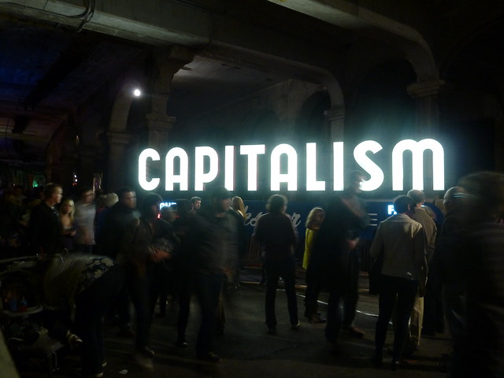
Liberalism and Capitalism
Liberalism in the economic field is based on the principles of personal freedom, private property, and limited government intervention.
With each individual pursuing their own interests, the best interests of society are served.
The forces of a market economy based on free competition will guide production, exchange, and distribution in a way that no government can fix. Therefore, the government's role is limited to protecting property rights, enforcing contracts for the supply of public goods, and maintaining internal and external security. Liberalism in this context contributes to capitalism.
This Photo by Unknown Author is licensed under CC BY

Slide 7
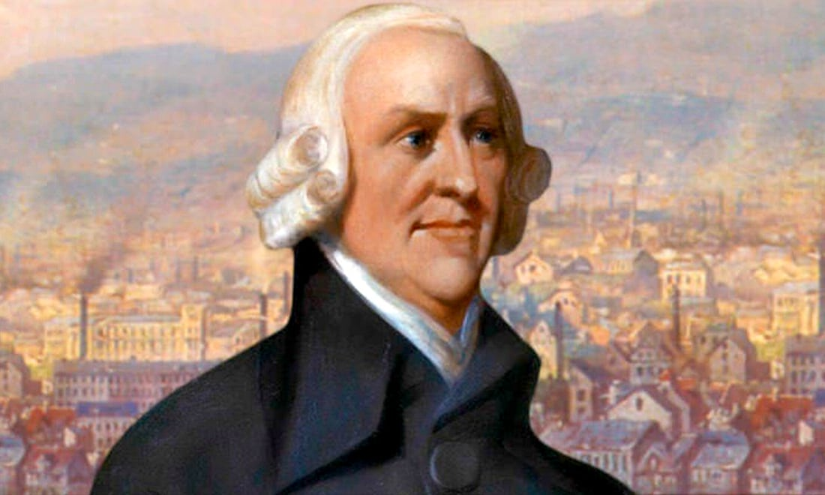
Adam Smith (1723-1790).
Smith is known as a thinker who is persistent in fighting for and defending the free market in economics (K. Bertens, 2013, p. 111).
Smith explained that the free market system presupposes private property rights. In line with Locke, Smith underlined the importance of private property. However, Smith differed from Locke on the nature of private property.
For Locke, private property rights are natural, while for Smith, only common property rights are natural, while private property rights are artificial (see, A. Sonny Keraf, 1996, p. 149). According to Smith, work is a natural means of obtaining private property.
Regarding the role of the state in economic activity, Smith ((see, A. Sonny Keraf, 1996, p. 172) argues that government intervention or control over everyone's economic activities should be rejected. State intervention will harm economic activity. According to Smith, every people know better than rulers what is best for themselves.
This Photo by Unknown Author is licensed under CC BY-SA-NC

Slide 8
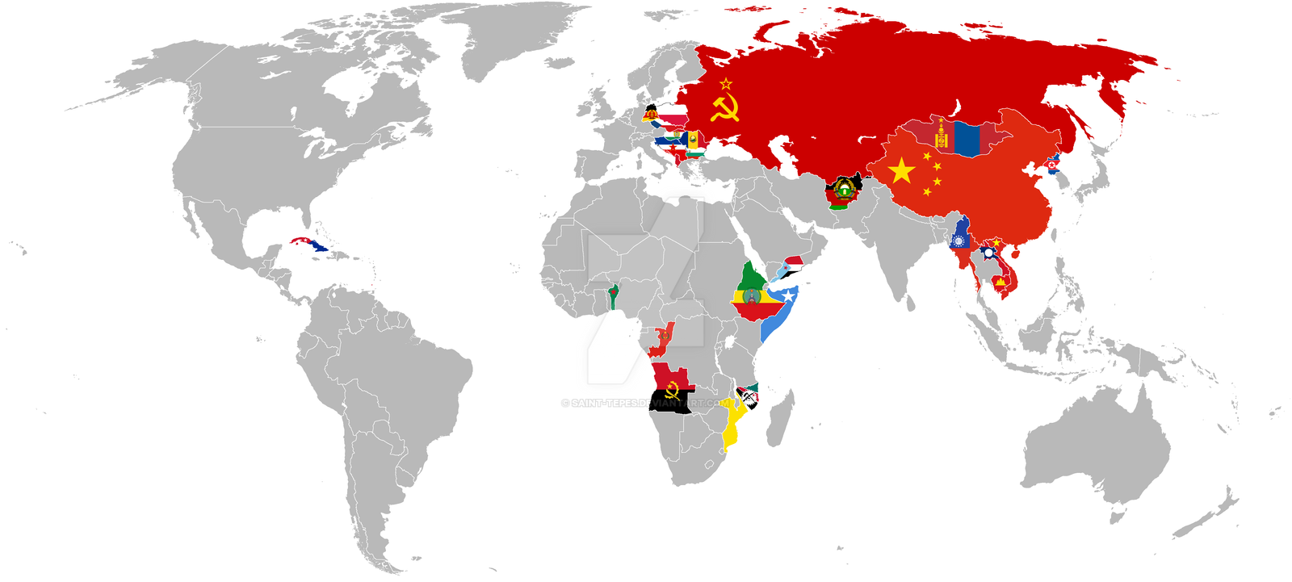
(2) Communism
Communism and socialism both aspire to create a classless society.
According to communism, liberalism creates social inequality and class society. There are classes that control production and there are classes that own nothing.
Therefore, communism and socialism aspire to abolish social class in society. A classless society will guarantee equality and social welfare.
The mechanism used is to reduce individual freedom and private property rights on the one hand, and increase state power on the other.
Thus, socialism and communism abolishes or limits private property and replaces it with common ownership of the means of production.
This Photo by Unknown Author is licensed under CC BY-SA

Slide 9

(3) Pancasila
Pancasila in principle does not adhere to one of the two ideologies mentioned above, namely liberalism or socialism.
Pancasila is based on five basic values, namely the values of Divinity, Humanity, Unity, Deliberation and Social Justice. These five basic values are constitutionally formulated as follows:
1. God Almighty
2. A just and civilized humanity
3. Indonesian Union
4. Democracy led by wisdom in deliberation/representation
5. Social Justice for all Indonesian people
This Photo by Unknown Author is licensed under CC BY-NC-ND

Slide 10
Pancasila Values | Liberalism | Socialism
God Almighty | Civil Rights
A just and civilized humanity | Civil Rights
Indonesian Union | Civil Rights | Group as main
Democracy led by wisdom in deliberation/representation | Citizens' Political Rights are recognized (political rights)
Social Justice for all Indonesian people | Social Rights | Social welfare is organized by the state

Slide 11
Discussion
Describe the differences among Pancasila and other ideologies!
Describe the supremacy of Pancasila from other ideologies as the ideology of Indonesia!

Slide 12
Referensi
A. Sonny Keraf (1996), Pasa Bebas Keadilan & Peran Pemerintah, Telaah Atas Eika Politik Ekonomi Adam Smith, Yogyakarta: Penerbit Kanisius
David Held, et all (1985), State & Society, Oxford, UK: Basil Blackwell
Franz Magnis-Suseno, (2016), Etika Politik, Prinsip-Prinsip Dasar Kenegaraan Modern, Jakarta: PT Gramedia Pustaka Utama
John J. Macionis (1989), Sociology, 2nd edition, New Jersey: Prentice Hall
K. Bertens, (2013), Pengantar Etika Binis, Yogyakarta: Penerbit PT Kanisius
Samuel Freeman, (2013), Liberalism, https://cpb-us-w2.wpmucdn.com/web.sas.upenn.edu/dist/e/483/files/2018/07/liberalism_oup_encyclopedia_politics-1o2lwvr.pdf
Ramlan Surbakti (1999), Memahami Ilmu Politik, Jakarta: Penerbit PT. Gramedia Widiasarana Indonesia.
Pancasila Bung Karno, Diterbitkan oleh Badiklat Pusat PDI Perjuangan, Agustus 2019

